Slide 1
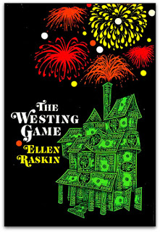
The Westing
Game
By: Ellen Raskin

Slide 2
dejectedly
Sad; depressed; low spirits

Slide 3
guffaw
A burst of deep, loud, hearty laughter

Slide 4
interrogate
Pose a series of questions to

Slide 5
ritual
Any customary observance or practice

Slide 6
scrumptious
Extremely pleasing to the sense of taste

Slide 7
smirking
Smiling in a way that shows that you feel smarter than someone else

Slide 8
eluding
Escaping understanding

Slide 9
glutton
A person who is devoted to eating to excess

Slide 10
culled
To gather or collect in a group

Slide 11
gaunt
Tall an thin to the point of looking ill

Slide 12
malady
Sickness, illness, disease

Slide 13
manipulated
Control others or oneself or influence skillfully

Slide 14
Miscalculation
A mistake in calculationg

Slide 15
shard
A fragment or piece of an object

Slide 16
adjacent
Having a common boundary or edge

Slide 17
burly
Big and strong; heavy and muscular

